Slide 1
Multilabel Classification of Patent Text: An Assessment of IPC Adoption
Michael Bryan
Open Environments
August 9, 2019

Slide 2




Context
Patents are important large economies
Increasingly a matter of global security
United Nations coordinates practices across countries
In 2015, the U.S. adopted WIPO’s IPC standard
2018 was the first full year of U.S. use of IPC

Slide 3

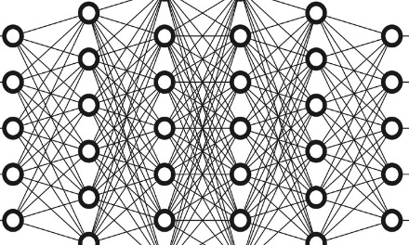
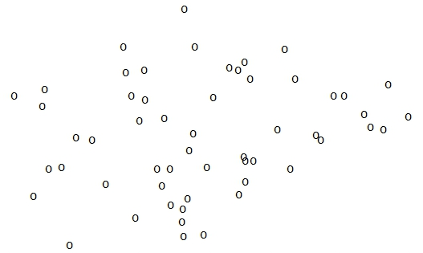
Assessment
Are IPC codes evenly assigned?
Chi squared with multiple comparison
Can IPC code assignments be automated?
Machine learning with word embedding
Can anomalous assignment be detected?
Binomial distribution and the sigmoid

Slide 4
Patent Text
USPTO publishes new patents weekly in “Red Book”.
In 2018, there were 309,360 patents granted.
Each includes narrative descriptions and abstracts.
The text includes 3,390,338 unique terms
Used 1,629,204,688 times.
By contrast, the
Oxford English Dictionary
defines 171,476 unique words

Slide 5
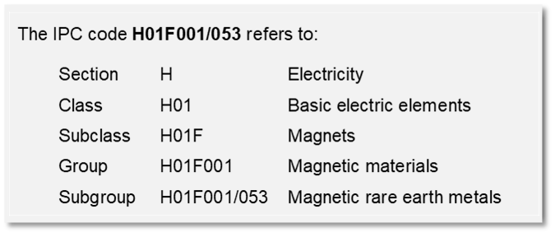
International Patent Classification
A hierarchical scheme of codes that tag subject matter
One or several IPCs are assigned to each patent
6,699 distinct IPCs were assigned 987,494 times

Slide 6
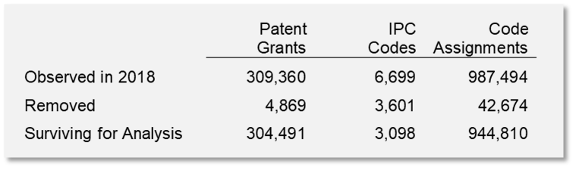
Study Data
Removing patents with less than 5K characters.
Removing IPCs that were rarely used.
Leaves an 11GB study set with these counts:

Slide 7
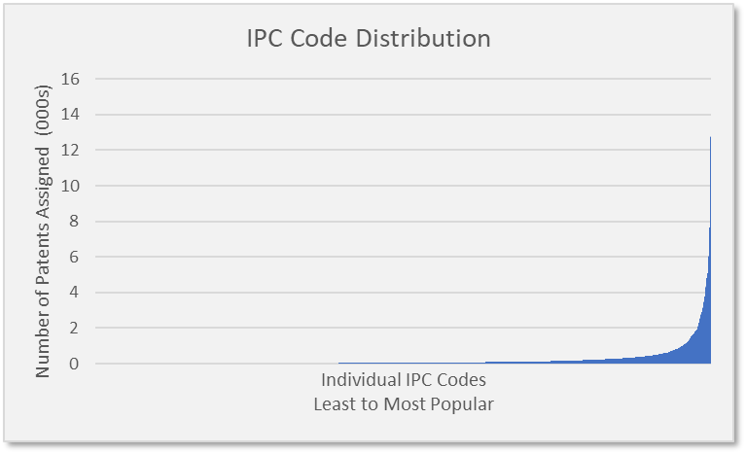
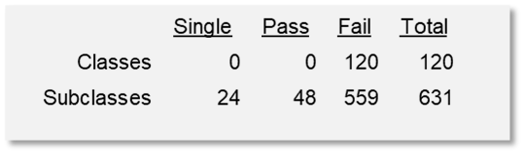
Evenness
Chi Squared Test of Uniformity
Bonferroni Adjustment for Multiple Comparison
At each level of the IPC hierarchy
48 passes of 752 tests
The most frequent 67 IPCs, or 1%,
represent 38.2% of all assignments!

Slide 8
Predictability
For a given patent text …
word embeddings convert the words to numeric vectors
of 300 latent dimensions on 100K frequent words
gives an input vector of 30 million
to a neural network with a custom loss function
which generates a vector of IPC probabilities.
Detail and references are available in the study report.
Trained 152,245 patent texts with 475,405 IPC assignments
Validated 152,246 patent texts with 461,890 IPC assignments
Predicted 208,966 assignments correctly or 45.24%

Slide 9

Anomaly Detection
The model developed above, given a patent’s descriptive text, will give a vector of probabilities $P$ by IPC code.
Consider an observed vector $Q$ with 0,1 identifying actual assignments. Then:
$$+1 missing IPC assignment$$
$$P−Q \sim 0 correct assignment$$
$$−1 incorrect assignment$$
If each IPC is treated as a binomial, each will have an observed and predicted variance. The variance of the differences, then is taken as the sum:
$$σ_{P−Q}^{2}=σ_{P}^{2}+σ_{Q}^{2}$$

Slide 10
Considerations
Correcting the lack of uniformity in IPC code assignments will directly impact a subsequent predictive model.
Word embeddings demonstrated in this study have multiple natural language applications. The USPTO should consider developing an internal embedding data resource for reuse and continual improvement.
A next step should include tuning algorithms and their associated optional parameters.
A target operational state warrants planning the proper compute environments for training and real time inference.

Slide 11
Major References
The preparation of this study relied on analytical, technical and functional sources including:
USPTO’s Bulk Data Storage System (USPTO)
WIPO’s IPC Master files specification version 2.1 (WIPO)
Stanford University’s GloVe algorithm (Pennington)
Keras Deep Learning Library (Chollet)
Natural Language Toolkit (Bird)
TensorFlow (Google)
Porter Stemming Algorithm (Porter)
University of Pennsylvania’s English Gigaword (LDC)
Princeton University’s WordNet Lexical Database for English (Fellbaum)

Slide 12
Multilabel Classification of Patent Text
Michael Bryan
https://github.com/michaelbbryan/patentclass
michael.b.bryan@gmail.com
(703) 638-3224

